Slide 1

Module 6
Recurrent Neural Networks
Notes:
Guidelines
Use section headers to chunk content in your presentation.
Use the same style of section header throughout your presentation.
Keep your title to no more than 2 lines.

Slide 2
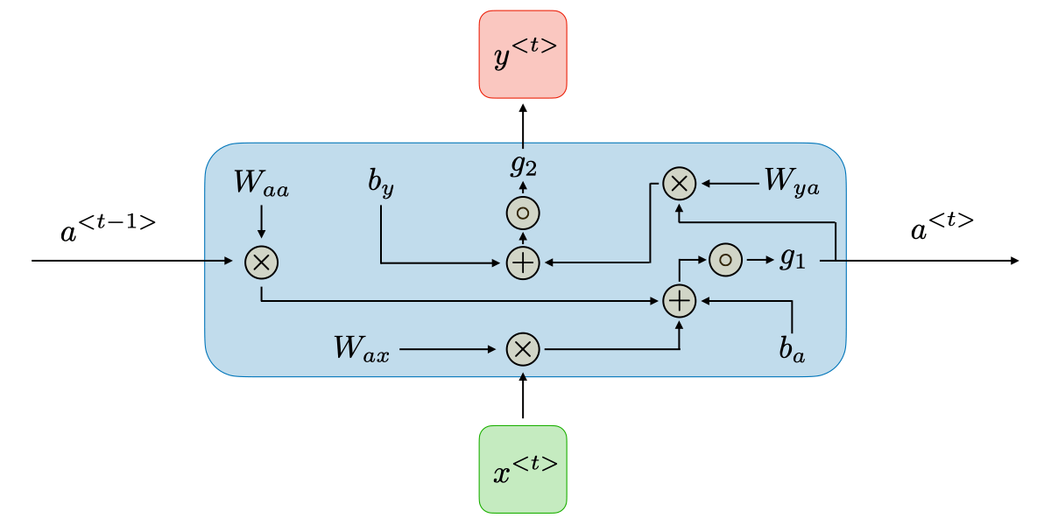
DL: RNNs
Notes:
Guidelines
Use a title slide at the beginning of your presentation. There are 9 variations of title slides to choose from.
If you will have a series of slideshows, we recommend using the same style of title slide for each presentation.
Keep your title to no more than 2 lines.
Do not change the font style or font size of the title or subtitle.

Slide 3
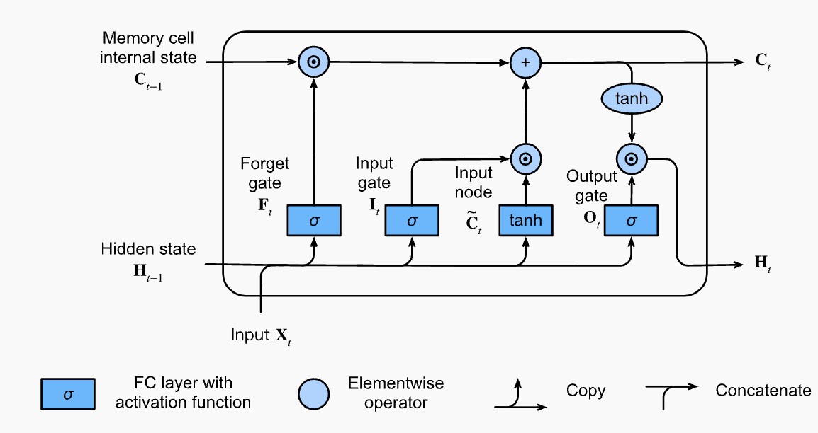
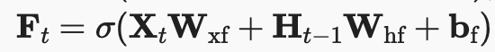
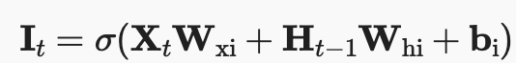
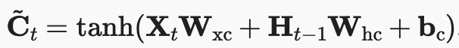
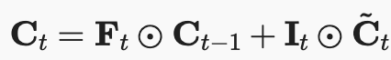
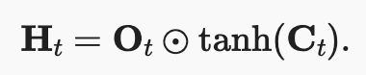
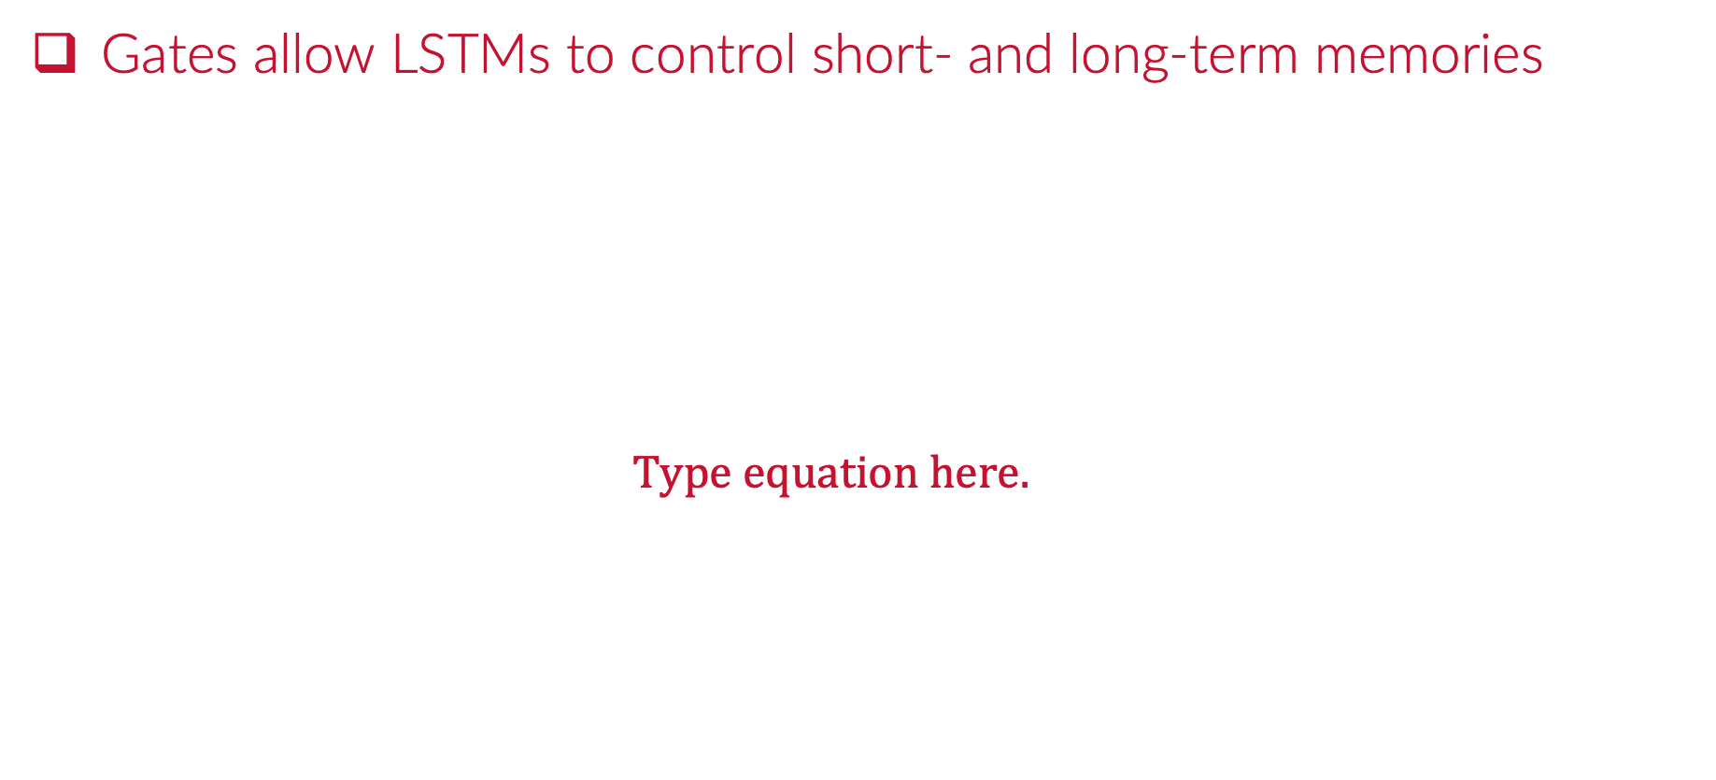
LSTM Gates
Gates allow LSTMs to control short- and long-term memories

Slide 4
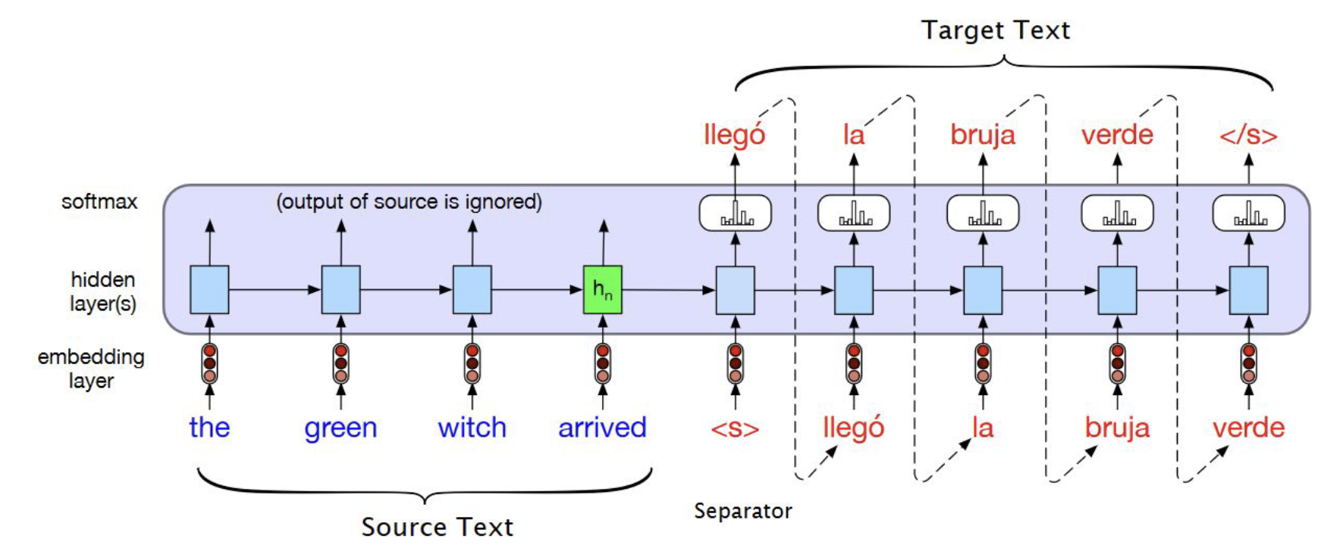
Encoder-Decoder LSTM
Seq2seq LSTM encoder-decoder networks

Slide 5

Attention Layers
Traditional models like RNNs and LSTMs treat all time steps equally.
In reality, some moments matter more than others.
Goal: Learn to focus on important time steps dynamically.

Slide 6
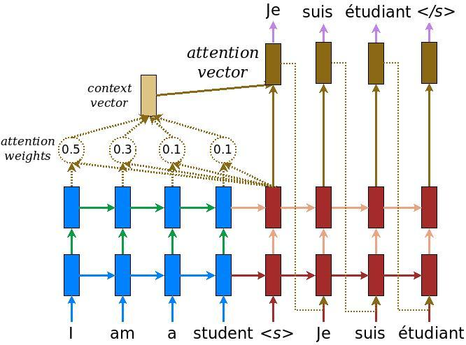
What is Attention?
A mechanism that lets models learn where to focus.
Assigns a weight to each input element.
Outputs a context vector summarizing important parts.

Slide 7
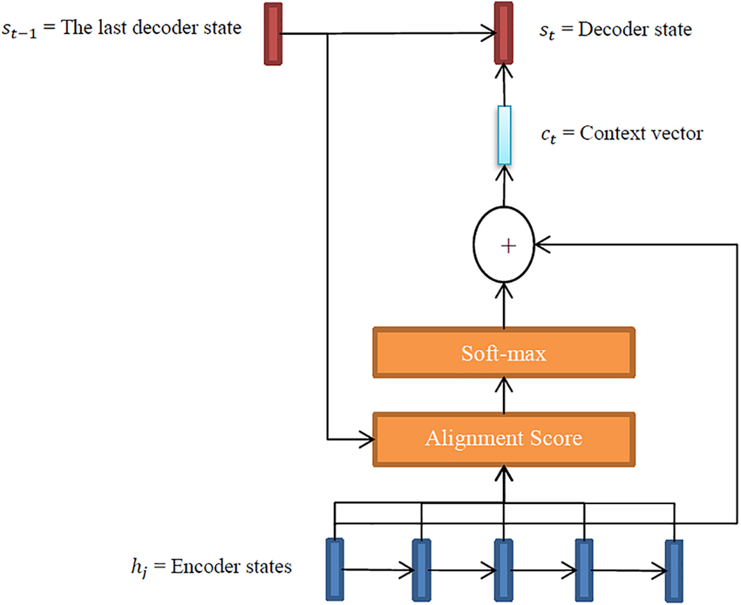
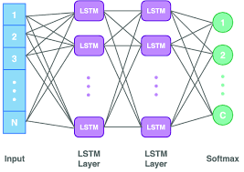
How Attention Works
Score each time step with a small neural network.
Apply softmax to get attention weights.
Multiply each hidden state by its weight.
Sum to get the context vector.

Slide 8

Attention Layers (Business Uses)
Besides the regular use of LLMs
Forecasting
Past sales, promotions, holidays, weather
Attention focuses on:
Holiday seasons
Promotional weeks
Special weather events

Slide 9
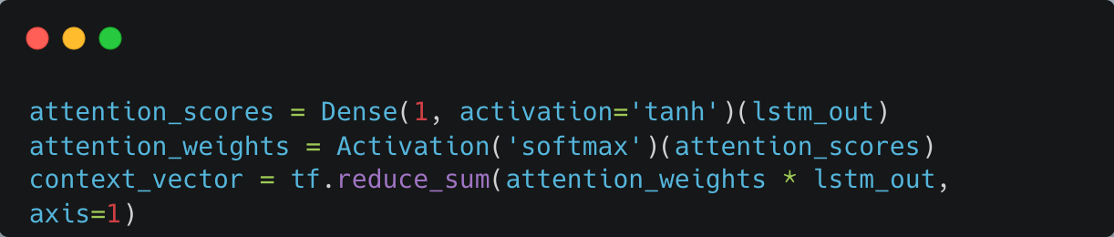
Attention Layers Anatomy
Example of Attention Layers:
Dense(1): Assigns a score to each time step.
Softmax: Normalizes into probabilities.
Reduce_sum: Dot Product creates the context vector.

Slide 10
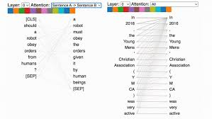
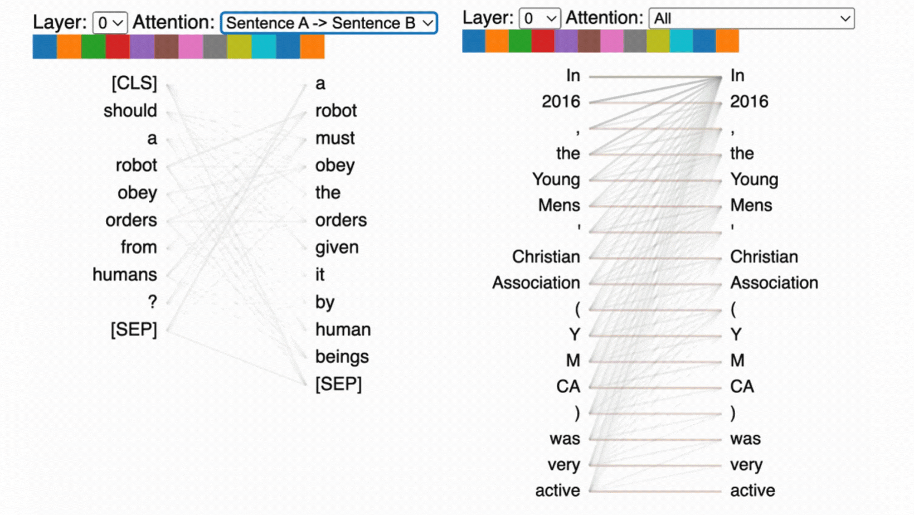
Benefits of Attention Layers
Improved Accuracy: Focus on key time steps.
Interpretability: Understand what the model "looks at."
Scalability: Easier learning for long sequences.

Slide 11
Python
Notes:
Guidelines
Use a title slide at the beginning of your presentation. There are 9 variations of title slides to choose from.
If you will have a series of slideshows, we recommend using the same style of title slide for each presentation.
Keep your title to no more than 2 lines.
Do not change the font style or font size of the title or subtitle.

Slide 12
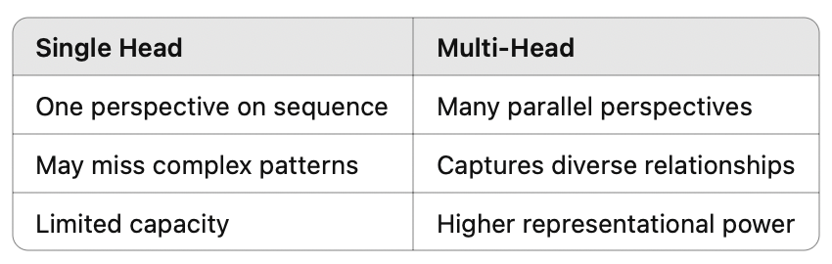
Multi-Head Attention Layers
Introduced in Transformer models.
Applies multiple attention heads in parallel.
Each head learns to focus on different aspects of the input.
Outputs from all heads are concatenated and linearly transformed.

Slide 13
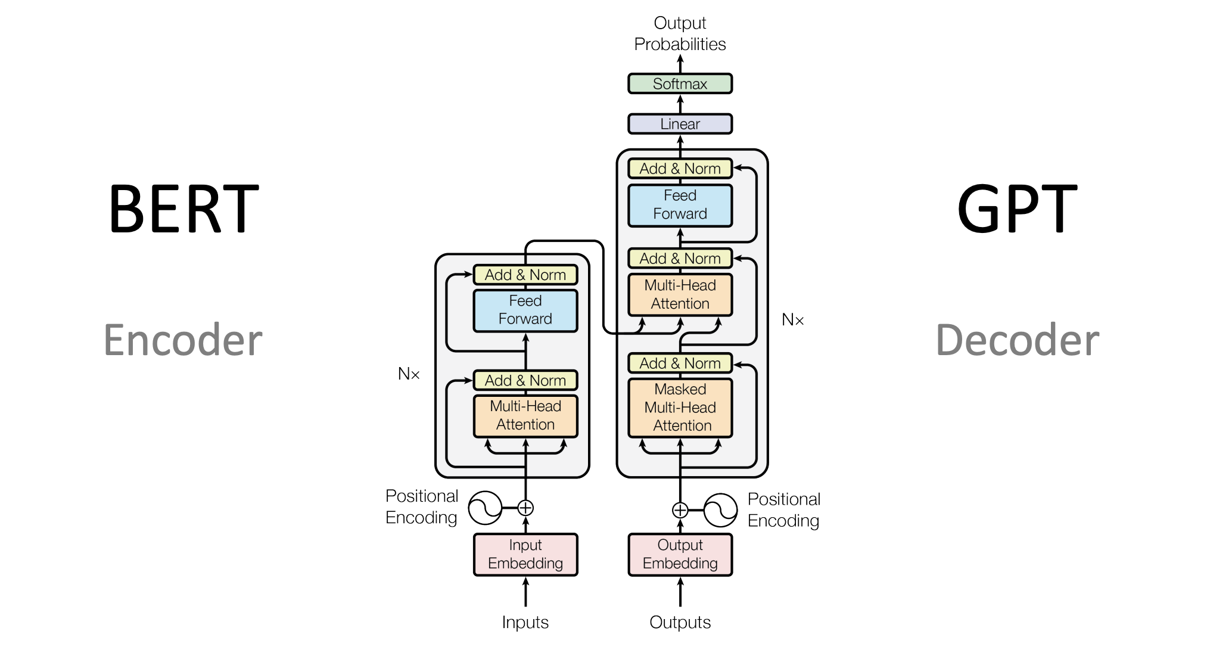
Multi-Head Attention Layers
Introduced in Transformer models.
Applies multiple attention heads in parallel.
Each head learns to focus on different aspects of the input.
Outputs from all heads are concatenated and linearly transformed.

Slide 14
Python
Notes:
Guidelines
Use a title slide at the beginning of your presentation. There are 9 variations of title slides to choose from.
If you will have a series of slideshows, we recommend using the same style of title slide for each presentation.
Keep your title to no more than 2 lines.
Do not change the font style or font size of the title or subtitle.

